Slide 1





001
STEGANOGRAPHY
NHUT LUONG

Slide 2
002
WHAT IS STEG?
the practice of hiding a secret message in something like an image
Today's Agenda

Slide 3
003
OBJECTIVES
Implement a way to send secret messages within images
Designing an application that can load, display and save
a .PPM image

Slide 4
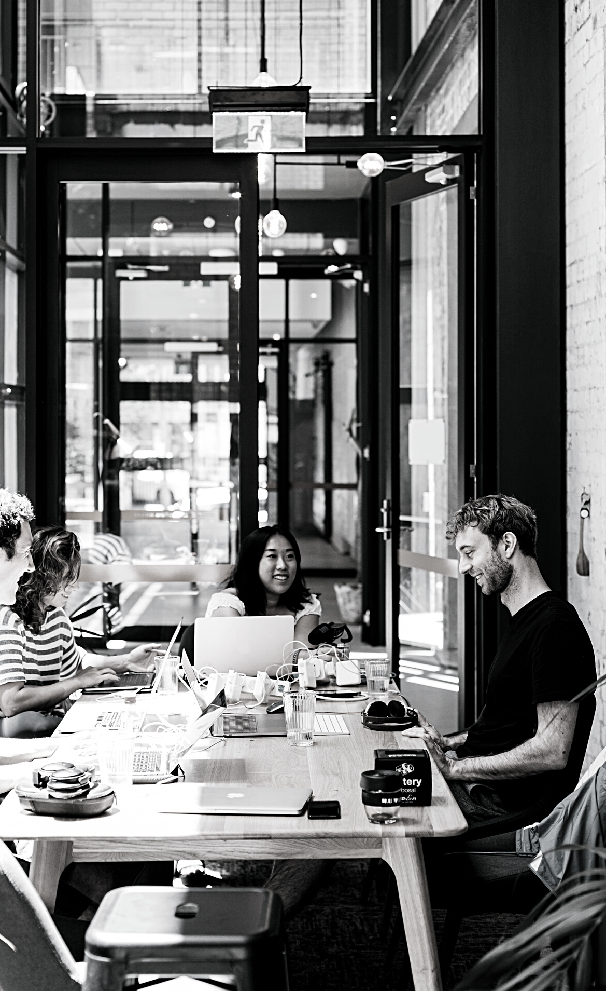
004
DESIGN TASKS
Design a WPF - Windows Presentation Foundation
Load, display, and save both P3 and P6 PPM image formats
Encode message into image
Decode message from image in second application

Slide 5
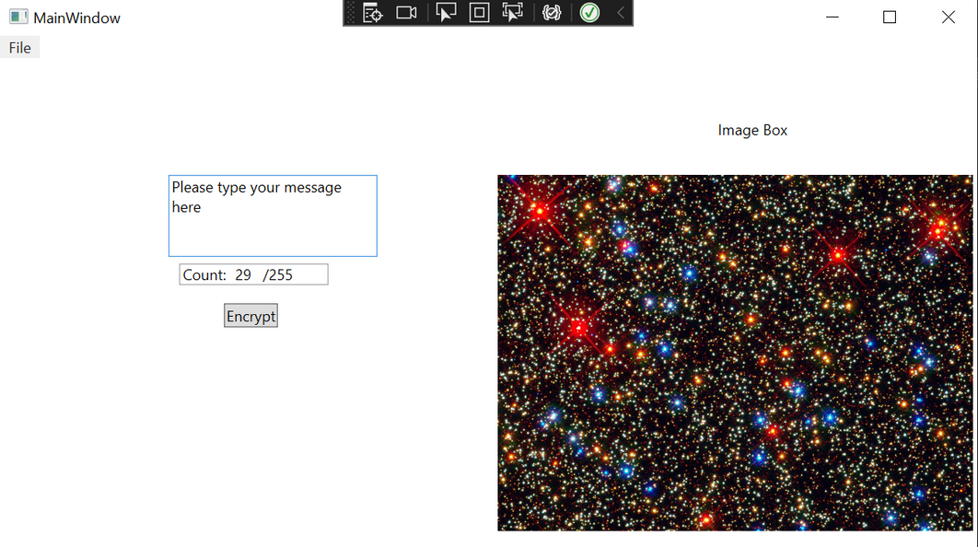
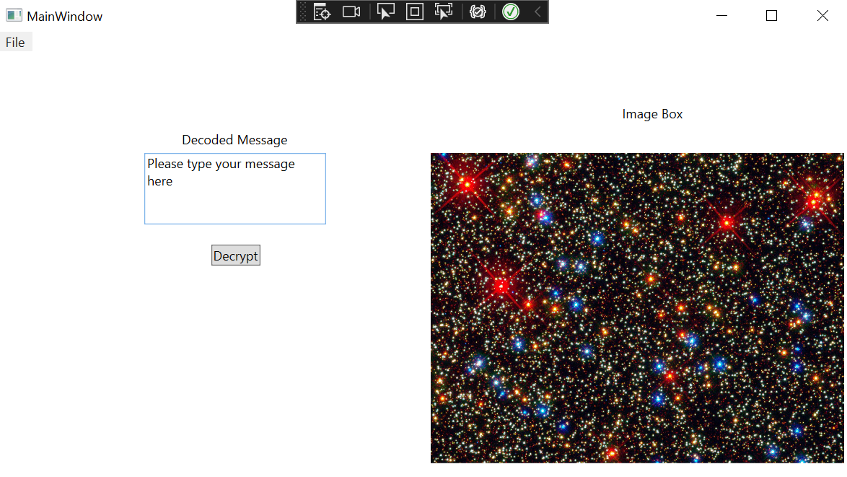
005
WPF - ENCODER
WPF - Decoder

Slide 6
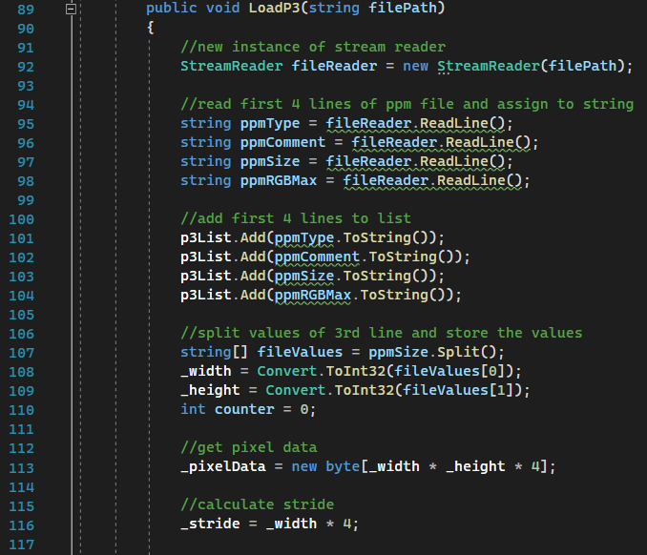
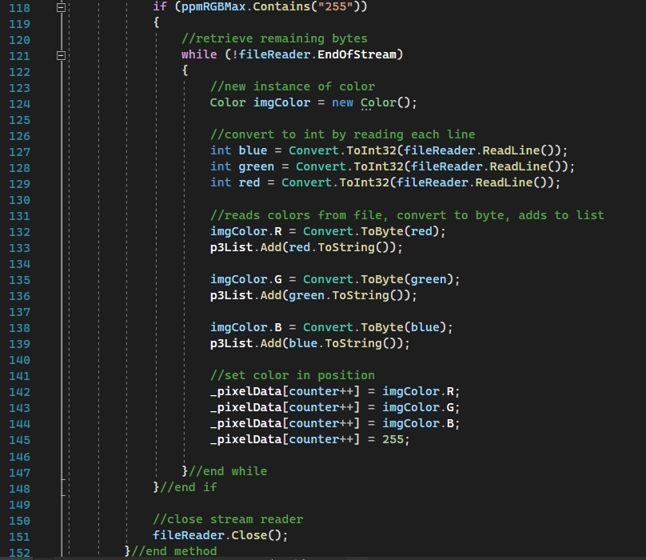
LOADING P3
006

Slide 7
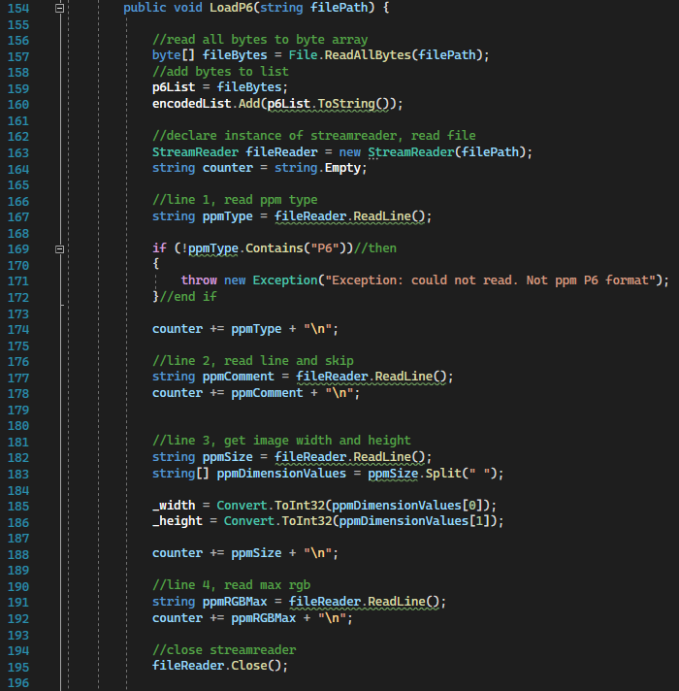
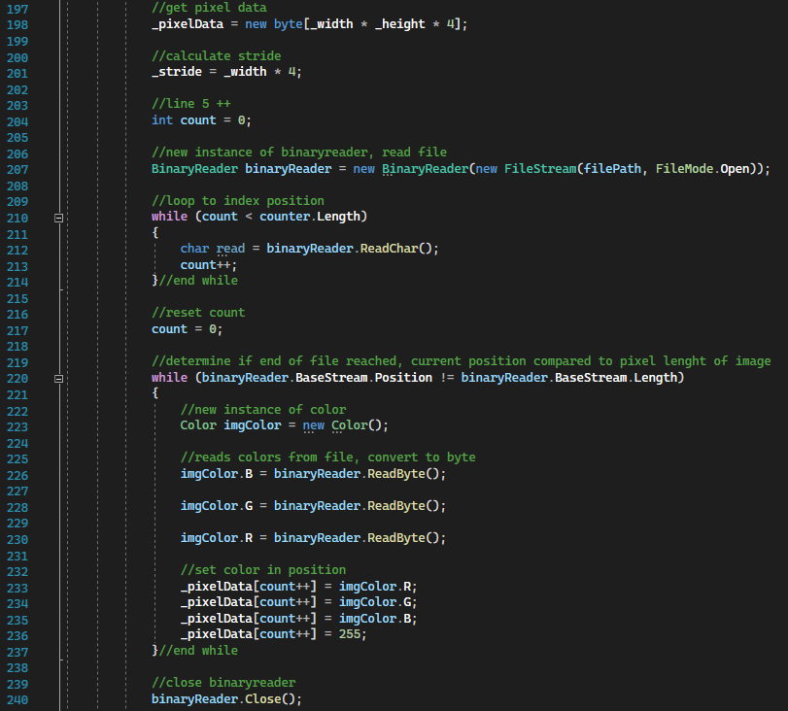
LOADING P6
007

Slide 8
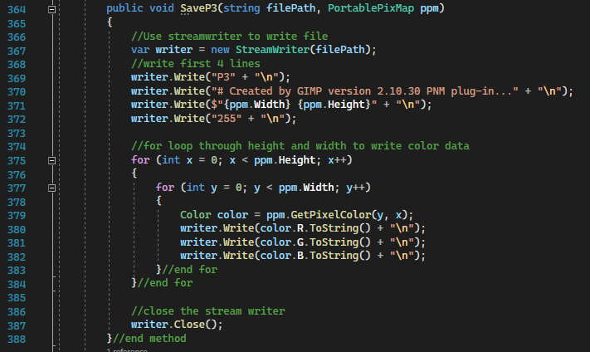
SAVING

Slide 9
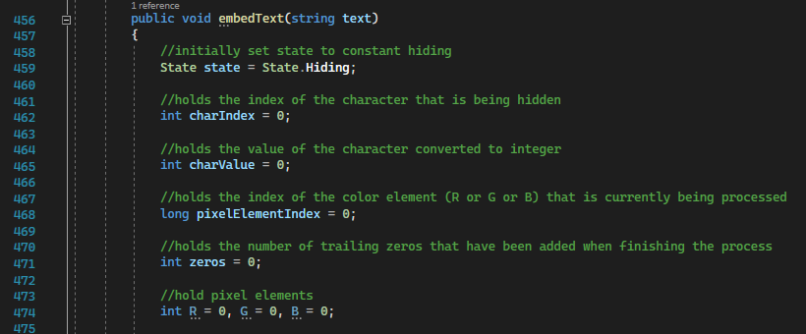
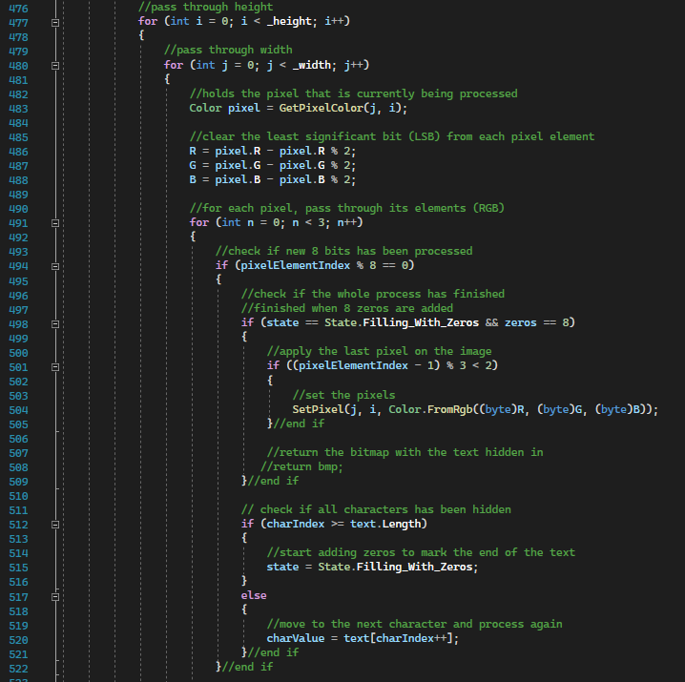
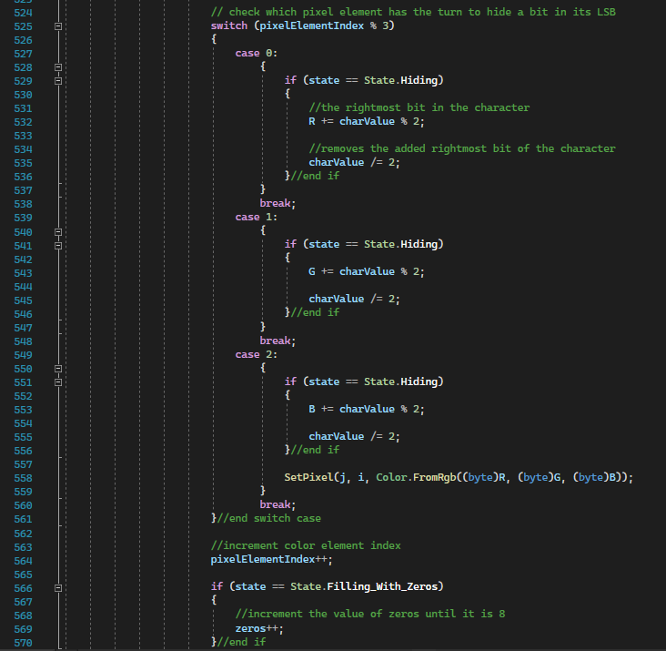
HIDING
009

Slide 10
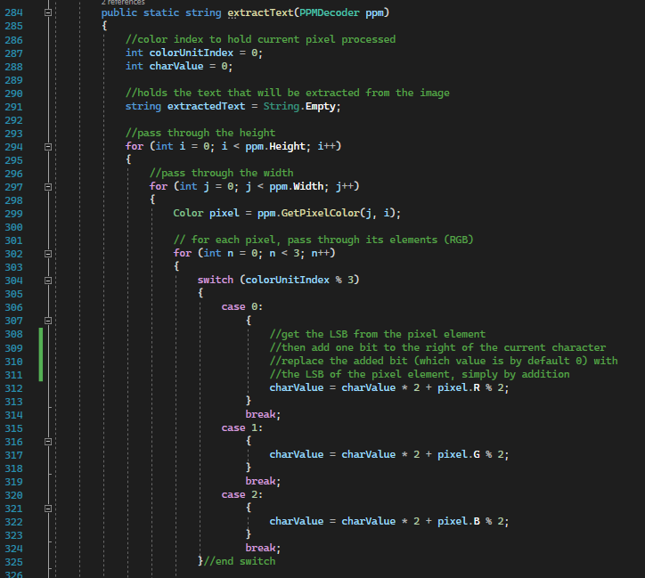
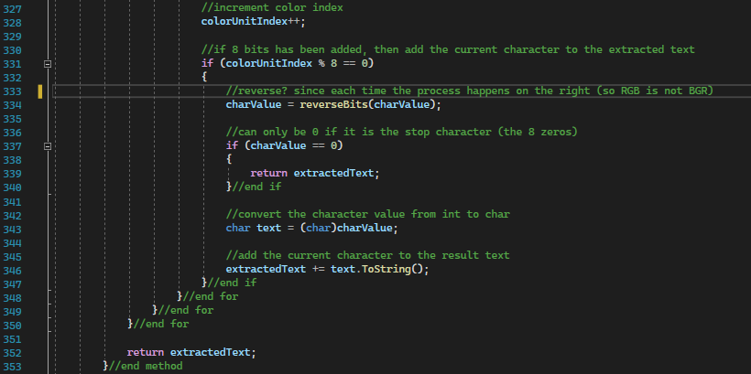
Decoding
010

Slide 11
011
SETBACKS
1
2
NHUTLUONG.GITHUB.IO
WPF design took longer than expected
Decoding an image with no hidden message will return some pixel data

Slide 12
012
NHUTLUONG.GITHUB.IO
THANK YOU
Special thanks to Kenny Tran and Andrew Stamps

